Slide 1


Mapping Hemochromatosis Genes using a Novel Recessive Diplotype Approach in the Marshfield Clinic Personalized Medicine Research Project (PMRP)
Shicheng Guo
Center for Precision Medicine Research
Marshfield Clinic Research Institute
03/13/2019
Notes:
Thanks for Steve’s warm introduction. it's an honor to give a presentation on the topic of Mapping Hemochromatosis Genes using a Novel Recessive Diplotype approach in the Marshfield Clinic Personalized Medicine Research Project (PMRP). I started this project with Steve last year.

Slide 2
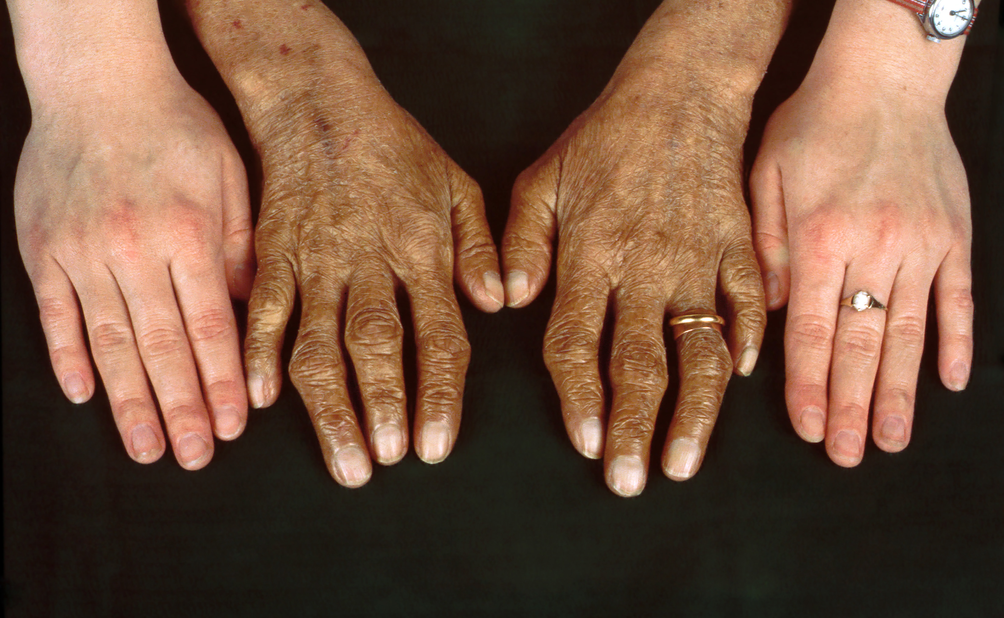
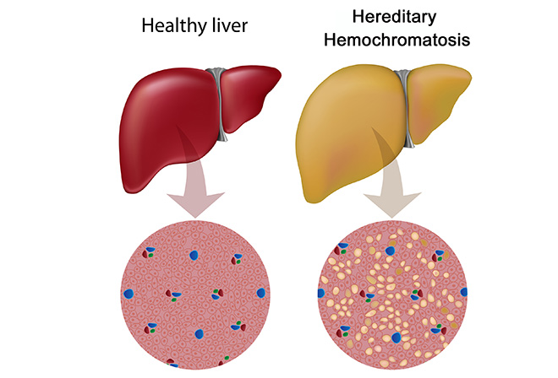
Hemochromatosis: clinical symptoms
Hereditary hemochromatosis (HH) is a genetic disorder characterized by excessive iron accumulation that results in multiple tissue damage
Liver disease (hepatomegaly, 13%; cirrhosis, 13%, usually late in the disease)
Skin bronzing or hyperpigmentation (70%)
Diabetes mellitus (48%)
Arthropathy
Amenorrhea, impotence, hypogonadism
https://www.youtube.com/watch?v=H4SAK7vgfUo
Notes:
Hereditary hemochromatosis is a genetic disorder characterized by excessive iron (Fe) accumulation that results in tissue damage. Manifestations can include systemic symptoms, liver disorders, cardiomyopathy, diabetes, erectile dysfunction, and arthropathy. Diagnosis is by elevated serum ferritin, iron, and transferrin saturation levels and confirmed by a gene assay. Treatment is usually with serial phlebotomies.
Type 1: Mutations of the HFE gene
Type 2 (juvenile hemochromatosis): Mutations in the HJV and HAMP genes
Type 3: Mutations in the TFR2 gene
Type 4 (ferroportin disease): Mutations in the SLC40A1 gene

Slide 3
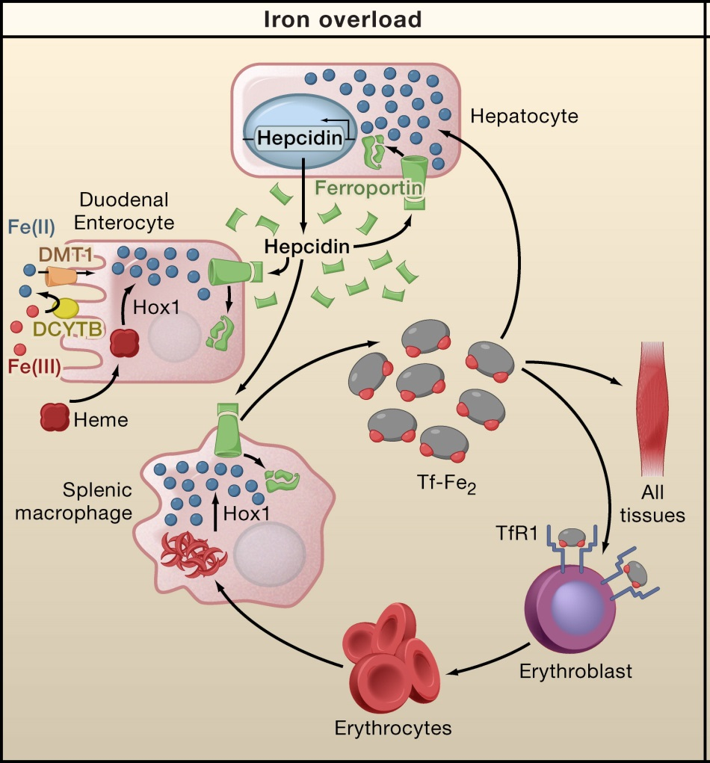
Human iron metabolism and iron homeostasis
liver cells
HAMP
Intestinal mucosal cells
SLC40A1
blood cells
Notes:
Human iron metabolism is the set of chemical reactions that maintain human homeostasis of ironat the systemic and cellular level. Iron is both necessary to the body and potentially toxic, and controlling iron levels in the body is a critically important part of many aspects of human health and disease.
Intestinal mucosal cells

Slide 4
Genetic etiology of hemochromatosis
 | Type 1 | Type 2A | Type 2B | Type 3 | Type 4
Name | Classic HHC | Juvenile HHC | Juvenile HHC | TfR2-related HHC | Ferroportin-related iron overload
Gene | HFE | HJV | HAMP | TfR2 | SLC40A1
Protein Produced | HFE | Hemojuvelin | Hepcidin | Transferrin receptor 2 | Ferroportin (iron regulatory protein)
Inheritance | autosomal recessive | autosomal recessive | autosomal recessive | autosomal recessive | autosomal dominant
Function | interruption of transferrin-bound iron, possible modulation of hepcidin regulation | unknown; possible hepcidin modulation | regulation of iron release in intestinal and blood cells | possible interference of iron uptake by liver cells | possible interference of iron export from intestinal, liver and placental cells
Organ Damage | variable | high | high | variable | low
Age of Onset | 40s or 50s | 20s or 30s | 20s or 30s | 40s or 50s | 40s or 50s

Slide 5
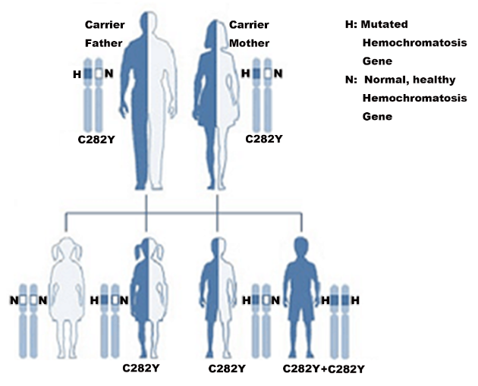
Hereditary hemochromatosis : Recessive Genetic Inheritance
HFE-hemochromatosis/HJV-hemochromatosis
If both parents are carriers of one C282Y mutation in HFE-hemochromatosis gene
25% HH affected, 50% carrier and 25% normal
If one of parents is affected and another one is C282Y mutation carrier.
50% HH affected, 50% carrier
If both parents are affected (both of them have 2 C282Y)
100% HH affected

Slide 6
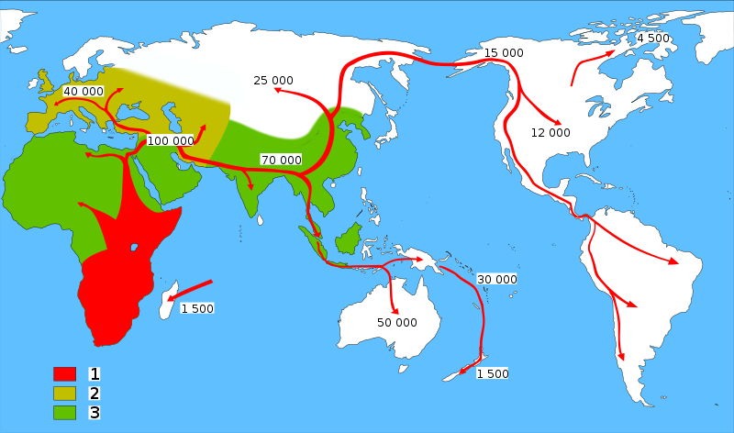
Type 1 Hemochromatosis and Human migrations
Neolithic Agricultural Revolution
C282Y ~6000
HFE C282Y, ~6000 years ago
85–90%: Northern European Descent
60%: Mediterranean populations
0% in Asian population
The C282Y allele is the major cause of hemochromatosis as a result of excessive iron absorption. The mutation arose in continental Europe no earlier than 6,000 years ago, coinciding with the arrival of the Neolithic agricultural revolution.
Tsui WM, et al. The C282Y mutation of the HFE gene is not found in Chinese haemochromatotic patients: multicentre retrospective study. Hong Kong Med J 2000;6:153-158.

Slide 7
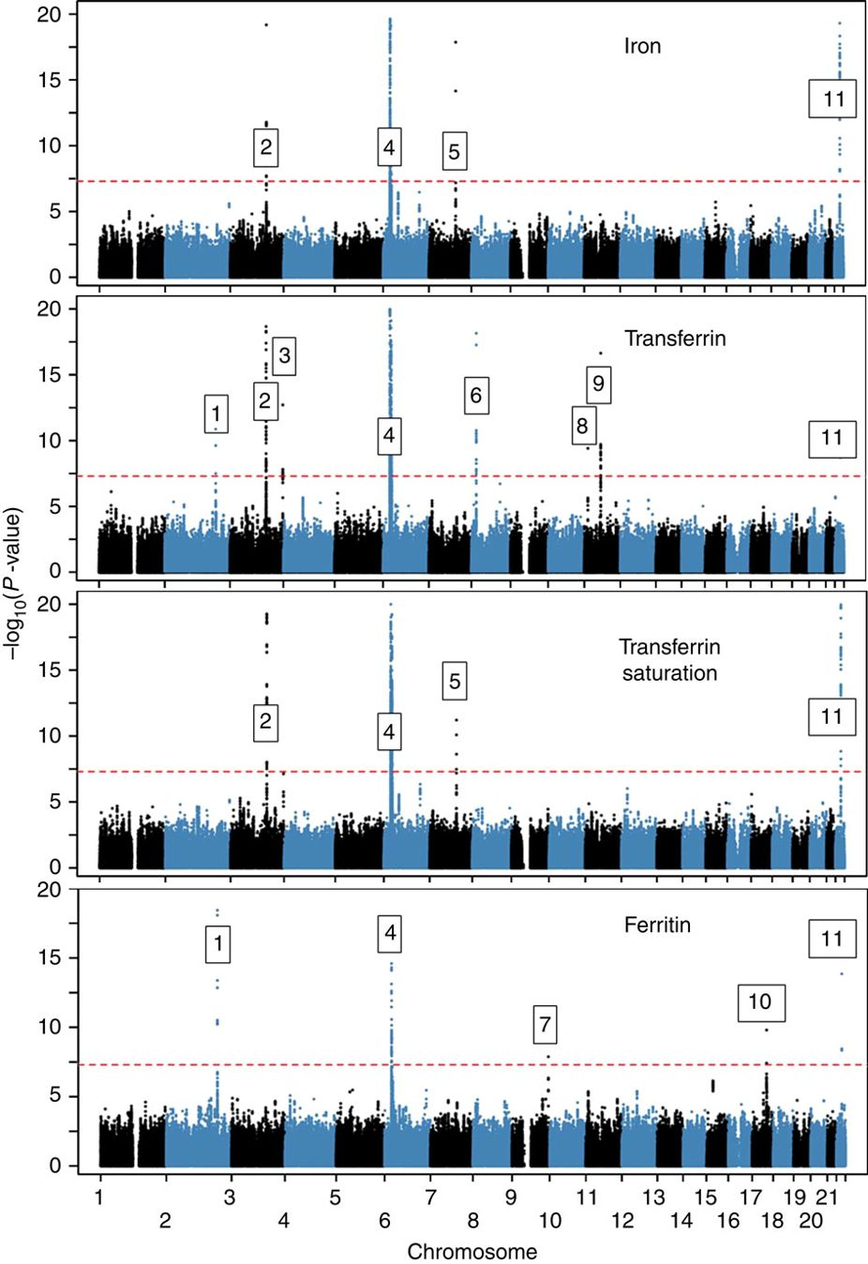
Novel loci affecting iron homeostasis and their effects in individuals at risk for hemochromatosis
HFE, HJV, HAMP, TFR2, SLC40A1
In 2014, Benyamin and colleagues find 11 genome-wide-significant (P<5 × 10−8) loci, some including known iron-related genes (HFE, SLC40A1, TF, TFR2, TFRC, TMPRSS6) and others novel (ABO, ARNTL, FADS2, NAT2, TEX14).
Discovery: 23,986 samples
Validation: 24,986 samples
Benyamin B, Esko T, Ried JS, Radhakrishnan A, Vermeulen SH, Traglia M, Gogele M, et al. Novel loci affecting iron homeostasis and their effects in individuals at risk for hemochromatosis. Nat Commun 2014;5:4926.

Slide 8
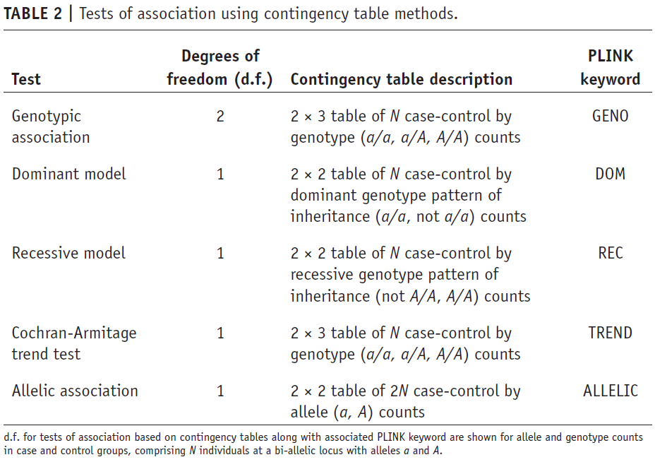
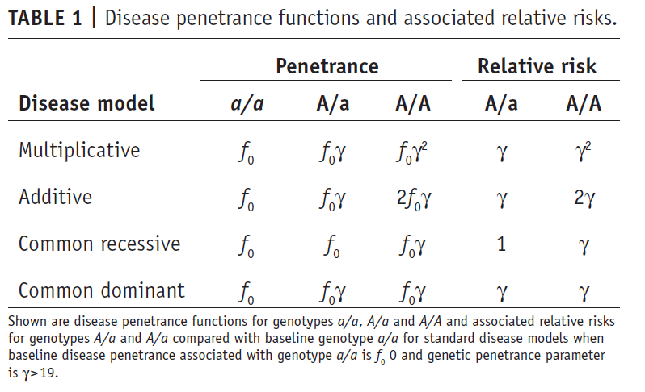
Disease penetrance functions, relative risks and association using contingency table methods

Slide 9
Exome-wide, Gene-based Recessive Diplotype Scan
Single Site Recessive Effects
Compound heterozygosity
Gene-by-Gene Scanning to Identify Disease Genes

Slide 10
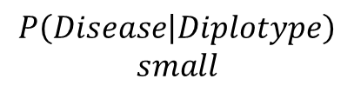
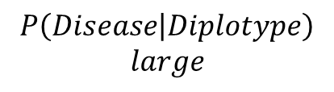
Recessive Diplotype Scan
Power calculations
2-locus model
Gene-based Monte Carlo
using 1000 Genomes
P₁₁
P₁₂
P₂₁
P₂₂
P₁₂ | P₁₂
P₁₁ | P₁₁
P₁₂ | P₂₁
P₁₁ | P₁₂
$$P\left(Disease | Diplotype\right)$$
$$small$$
P₁₂ | P₂₂
$$P\left(Disease | Diplotype\right)$$
$$large$$
P₁₁ | P₂₁
P₂₁ | P₂₁
P₁₁ | P₂₂
P₂₁ | P₂₂
P₂₂ | P₂₂

Slide 11
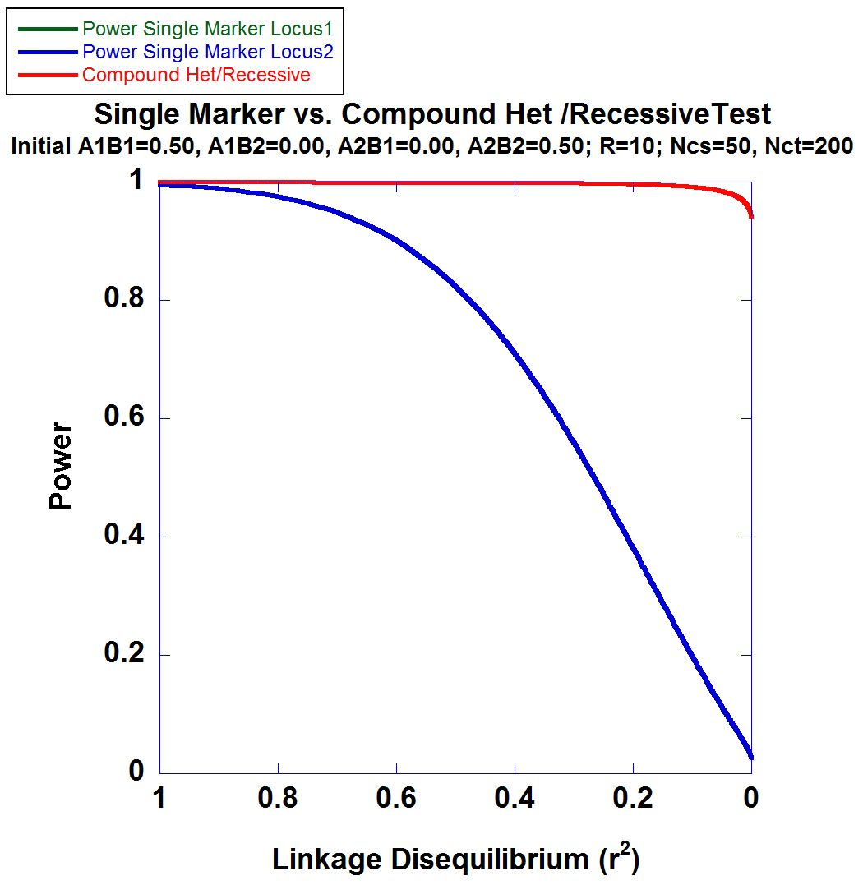
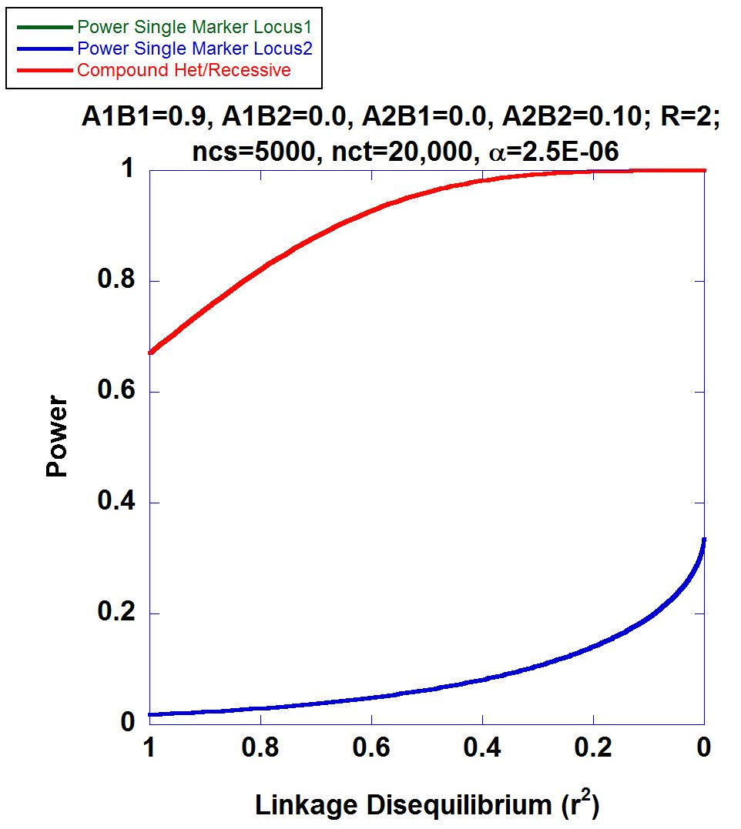
2-locus Power Calculations

Slide 12
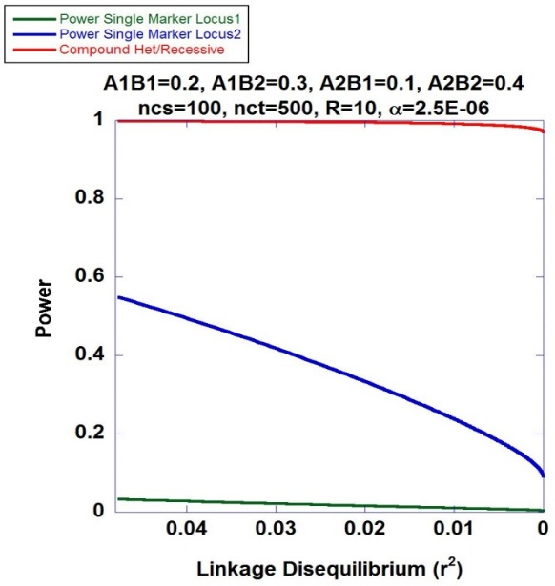
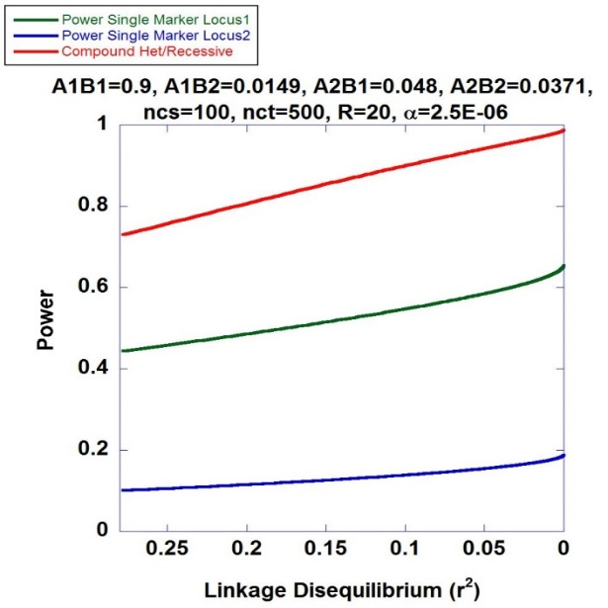
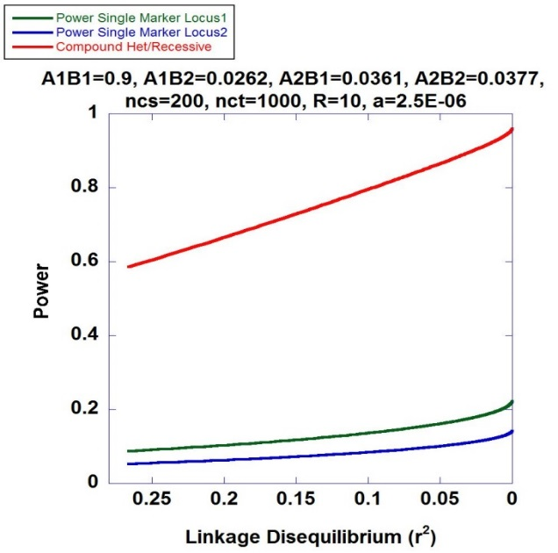
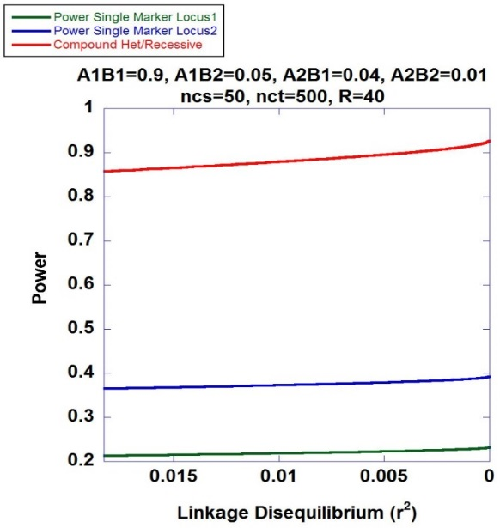
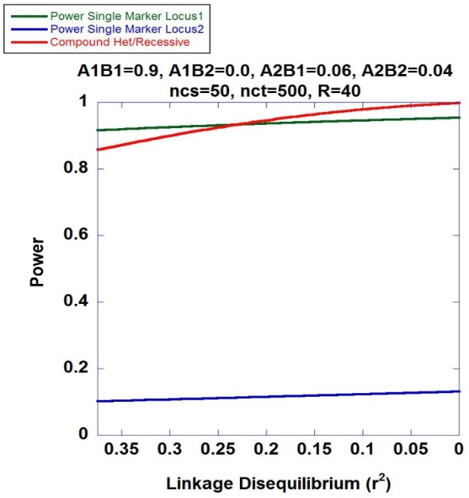
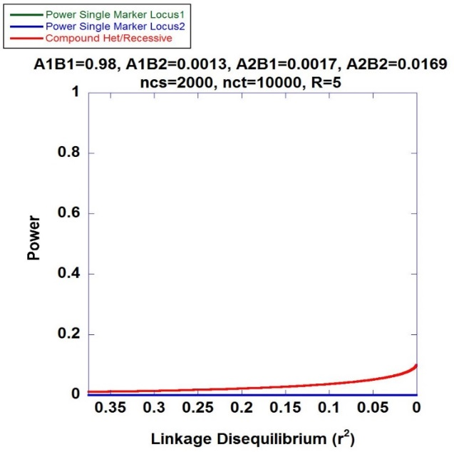
Higher Power of Recessive Diplotype Scan benefits PMRP

Slide 13
Mapping Hemochromatosis Genes using a Novel Recessive Diplotype approach in PMRP
Exome beadchip data used on 10,000 subjects
PCA used to exclude genetic background outliers
Phasing using localized haplotype clustering
Putative functional variants: GWAS-significant, nonsynonymous, 3’UTR, 5’UTR, or splice site
Two or more in silico pathogenic annotations
ICD9: two or more instances of (i) iron metabolism disorder, excluding anemia (ii) hereditary hemochromatosis, (iii) unspec hemochromatosis
Transferrin saturation (ratio of serum iron to transferrin iron-binding capacity) > 48%
18 cases identified and 6,896 controls

Slide 14
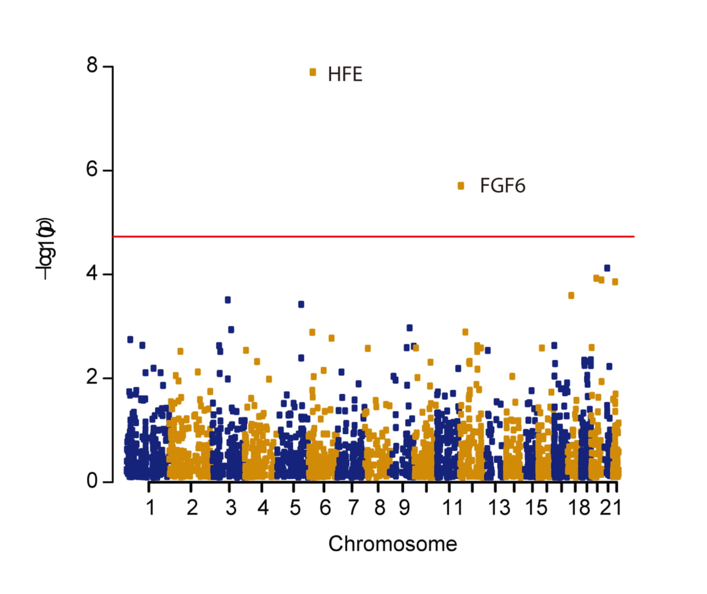
Manhattan Plot

Slide 15
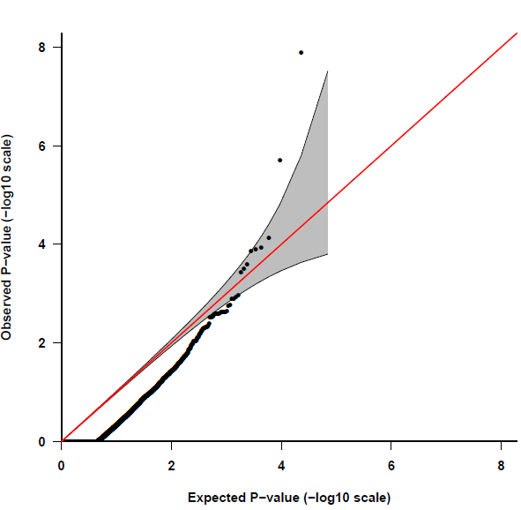
Quantile-Quantile Plot
HFE
FGF6
Fibroblast Growth Factor 6
Heparin-Binding Growth Factor 6
Heparin Secretory-Transforming Protein 2
FGF6
False positive Rate=0.08
Poli M, Girelli D, et al. Heparin: a potent inhibitor of hepcidin expression in vitro and in vivo. Blood 2011;117:997-1004.

Slide 16
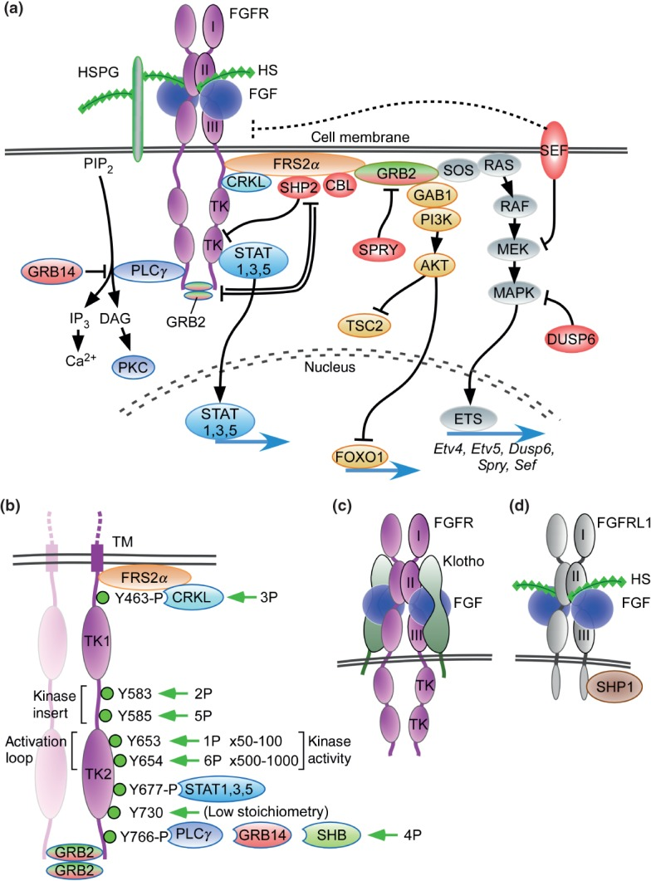
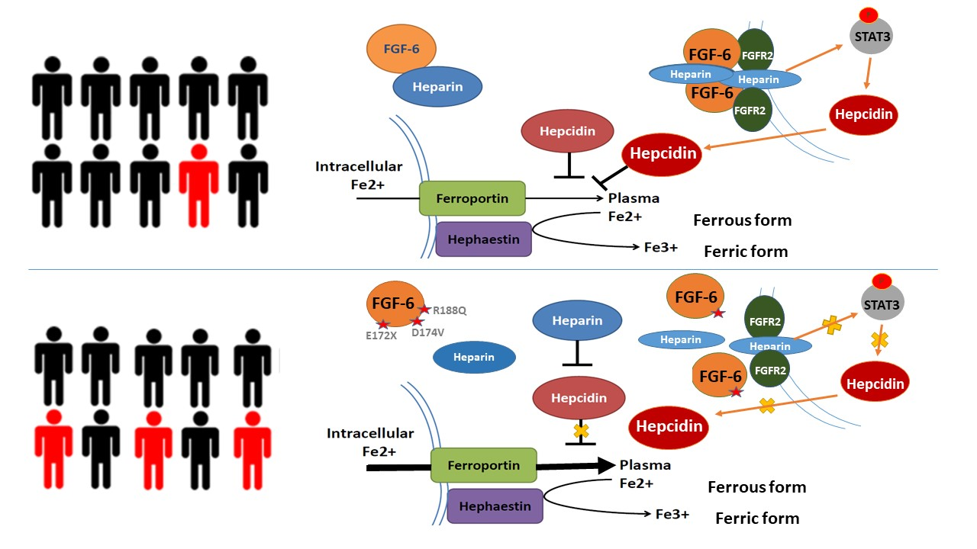
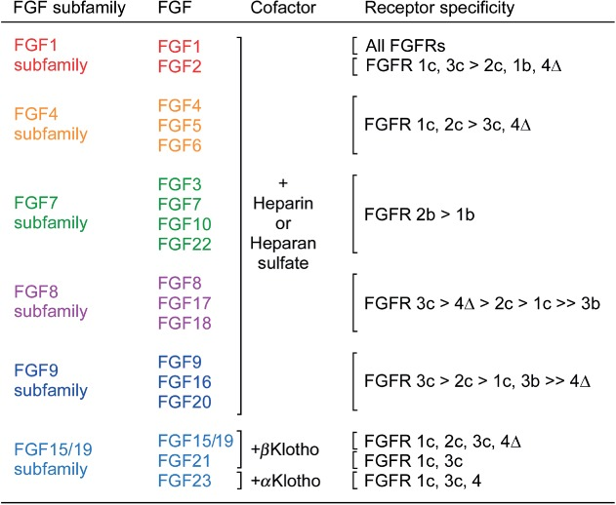
FGF6: gene family and pathway
Hepcidin (HAMP)
Heparin

Slide 17
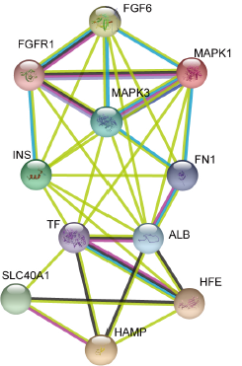
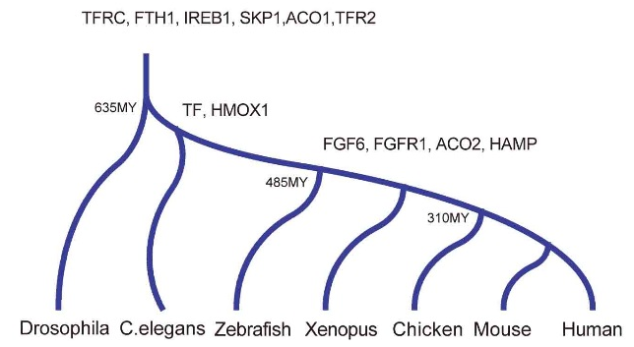
FGF6: molecular evolution and biological function
Encodes for the fibroblast growth factor 6 protein
Expressed across numerous tissues including skeletal muscle,
blood, liver and pancreas
Protein-protein interactions suggest
involvement of FGF-6 with Fe-metabolism
subnetwork

Slide 18
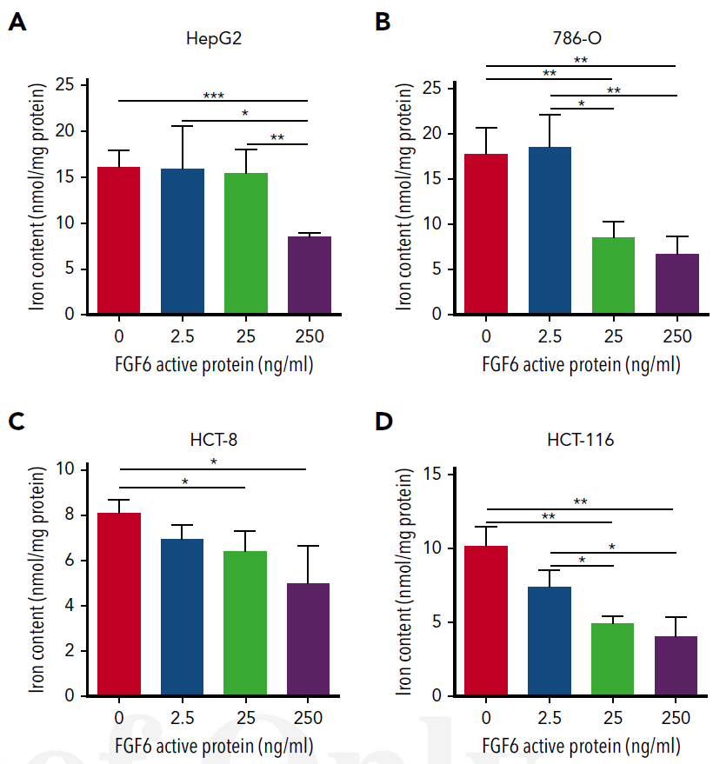
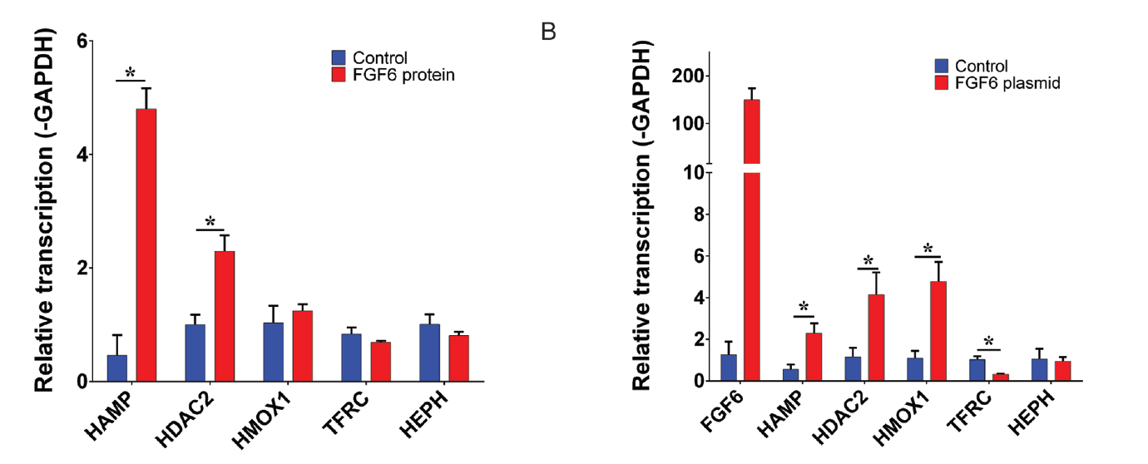
Dose-Dependent FGF-6 Impact on Intracellular Iron

Slide 19
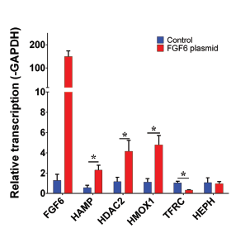
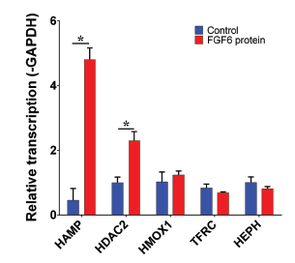
FGF-6 and FGF6 Transcriptional Regulation of Hepcidin (HAMP) in Hepatocytes
HAMP encodes for hepcidin
HDAC2 encodes for histone deacetylase 2
HMOX1 encodes for heme oxygenase 1
TFRC encodes for transferring receptor 1
HEPH encodes for hephaestin

Slide 20
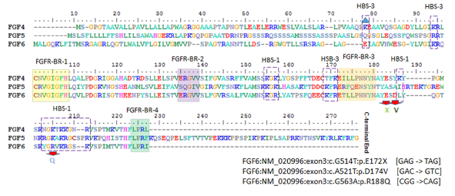
Evaluation of Three FGF6 Nonsynonymous Putative Functional Variants
Within or adjacent to heparin binding site motifs

Slide 21
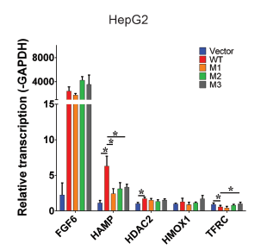
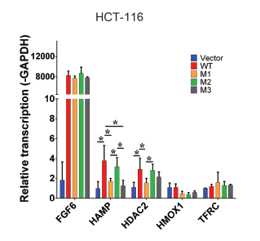
Variants Show Attenuation of Hepcidin Transcription Compared to Wildtype
M1: E172X
M2: D174V
M3: R188Q

Slide 22
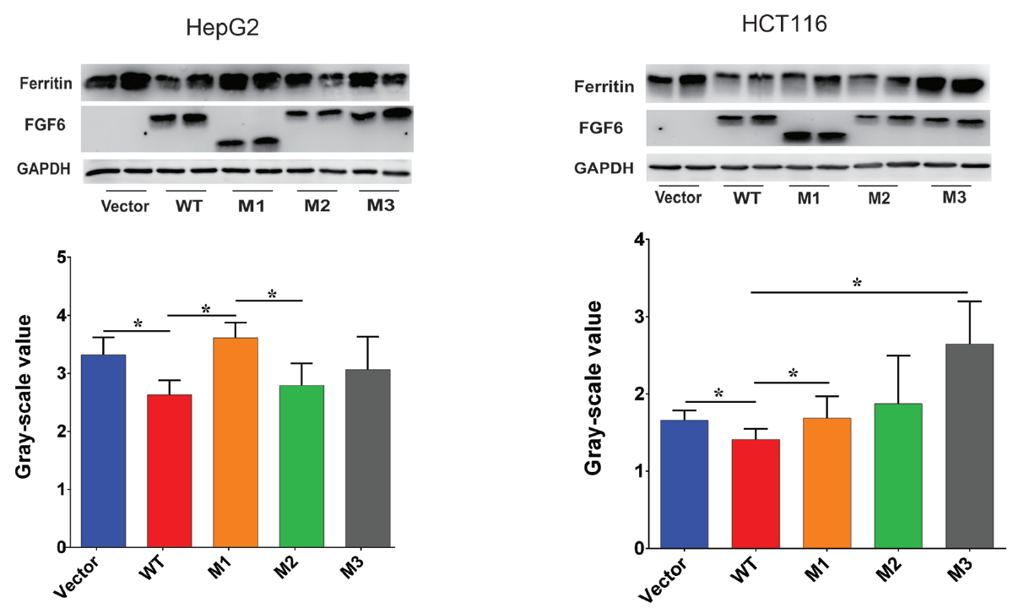
Variants Show Reduced Attenuation of Iron Uptake

Slide 23
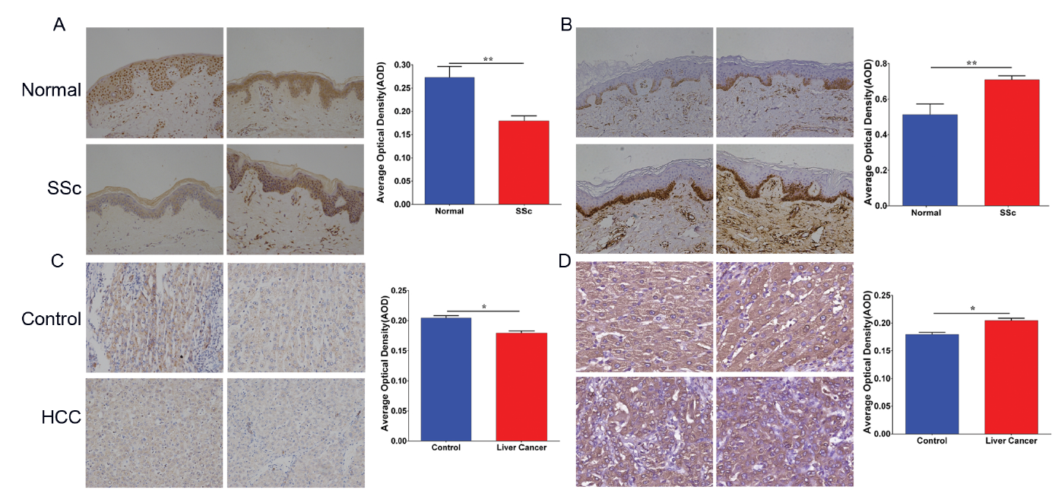
Low FGF6 expression and high iron deposition in liver cancer and systemic sclerosis
FGF-6 protein level
Ferritin protein level

Slide 24
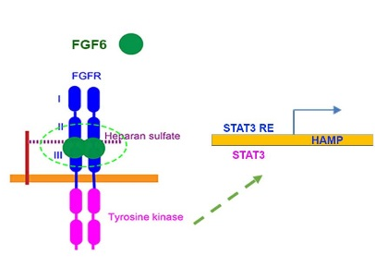
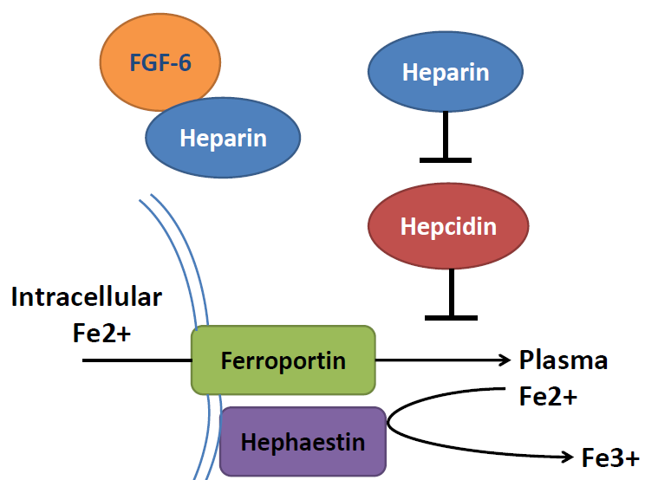
Marshfield Model: FGF6 decreases ferrous iron uptake in liver cells and induces increased hepcidin expression
Ferrous form
Ferric form

Slide 25
Marshfield Model: FGF6 decreases ferrous iron uptake in liver cells and induces increased hepcidin expression

Slide 26
Research contribution to clinical: new subtypes? drug target?
 | Type 1 | Type 2A | Type 2B | Type 3 | Type 4
Name | Classic HHC | Juvenile HHC | Juvenile HHC | TfR2-related HHC | Ferroportin-related iron overload
Gene | HFE | HJV | HAMP | TfR2 | SLC40A1
Protein Produced | HFE | Hemojuvelin | Hepcidin | Transferrin receptor 2 | Ferroportin (iron regulatory protein)
Inheritance | autosomal recessive | autosomal recessive | autosomal recessive | autosomal recessive | autosomal dominant
Function | interruption of transferrin-bound iron, possible modulation of hepcidin regulation | unknown; possible hepcidin modulation | regulation of iron release in intestinal and blood cells | possible interference of iron uptake by liver cells | possible interference of iron export from intestinal, liver and placental cells
Organ Damage | variable | high | high | variable | low
Age of Onset | 40s or 50s | 20s or 30s | 20s or 30s | 40s or 50s | 40s or 50s
Type 5
FGF6-related iron overload
FGF6
Hepcidin and FGF6
CH recessive
?
?
?

Slide 27
Perspective
Clinical characteristics of FGF6 caused hemochromatosis
* Prevalence
* Onset age
* Outcome
2. Disease gene mapping for other traits/diseases with PMRP
Obesity and Type I Diabetes,
Rheumatoid arthritis, Ankylosing Spondylitis,
Psoriatic Arthritis, Autoimmune thyroid disease

Slide 28






Acknowledgements
Brent Olson, MRCI
Terrie Kitchner, MCRI
Jeffrey Joyce, MCRI
Robert Strenn, MCRI
Joseph J. Mazza Jennifer K. Meece

Slide 29



Acknowledgements
Dr. Naren Epperla
OSU
Assoc Prof. Judy Smith
UW-Madison
Prof. Jiucun Wang
Fudan University

Slide 30
Thanks
Any questions about how to detect genetic variant for FGF6
Meet some rare diseases and want to know the genetic Pathogenesis
Leave message to Guo.Shicheng@marshfieldresearch.org
Don’t Shy. It is free…

